Slide 1

CORE TRANSACTION 3 DIAGRAMS
Mondido, Mark (Booking)
Caburian, James Ivan (Reservation)
Maghilom, Jericho (Customer/Guest Management)
Memoita, Kobe (Facility)
Escuyos, Kenneth (Customer Relationship

Slide 2
BUSINESS PROCESS MODEL AND NOTATION

Slide 3
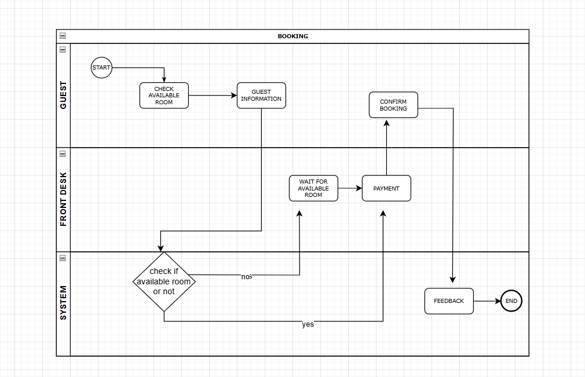
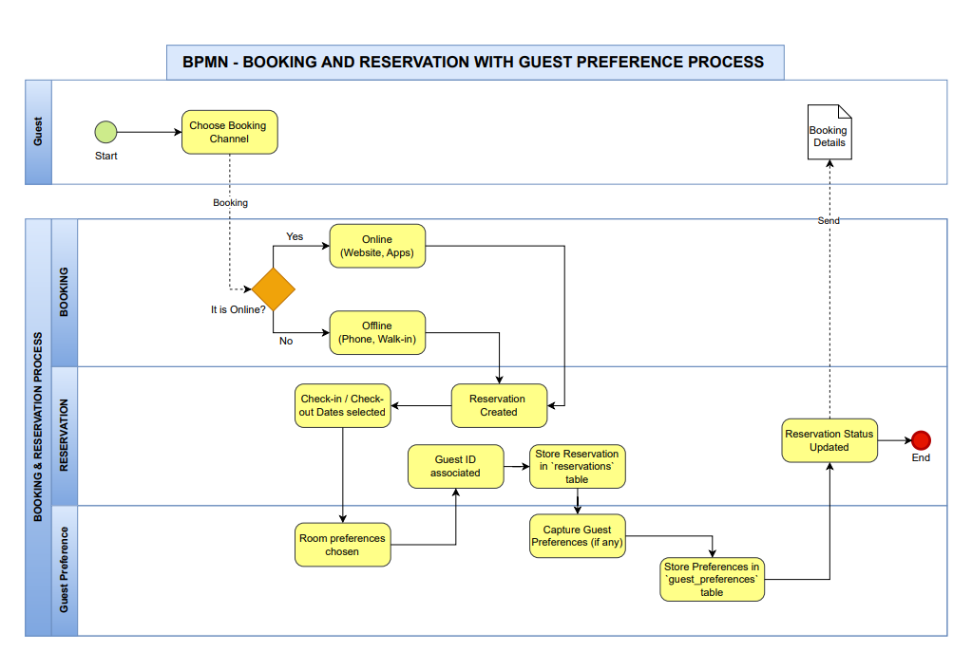
AS IS TO BE
BOOKING

Slide 4
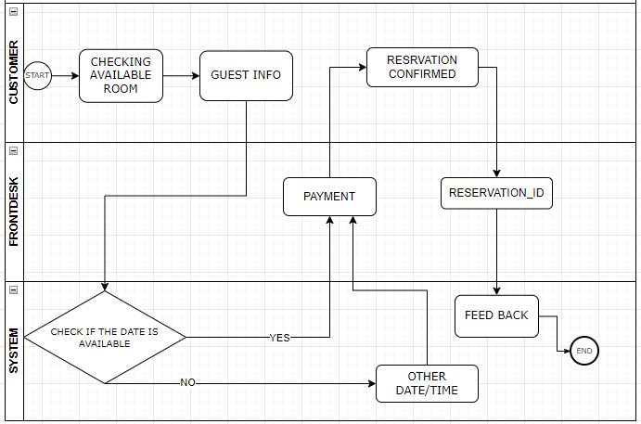
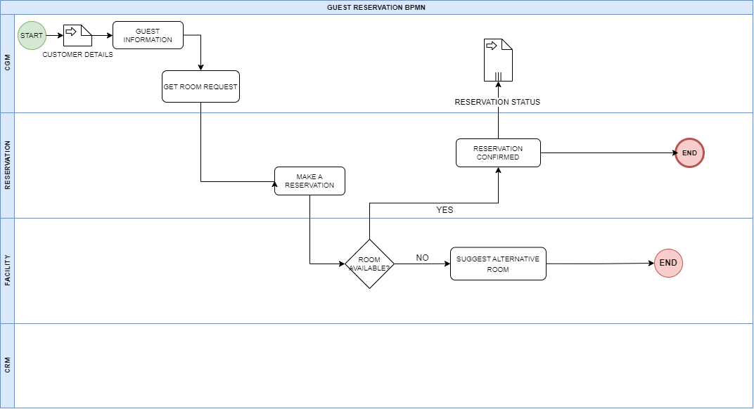
RESERVATION
AS IS TO BE

Slide 5
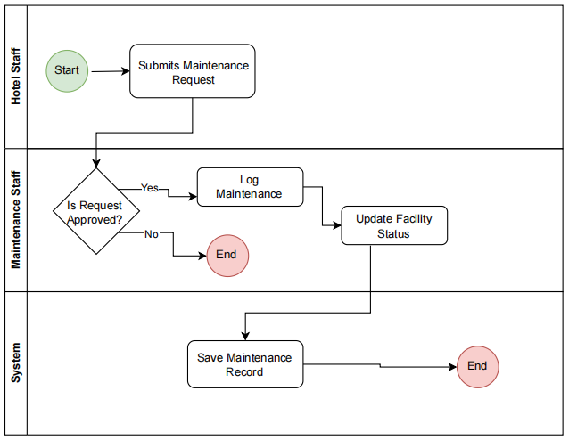
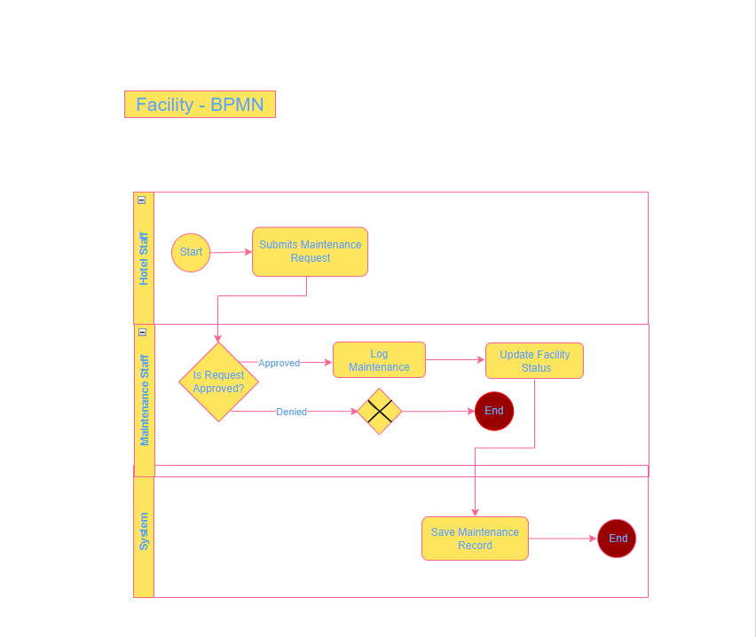
FACILITY MANAGEMENT
AS IS TO BE

Slide 6
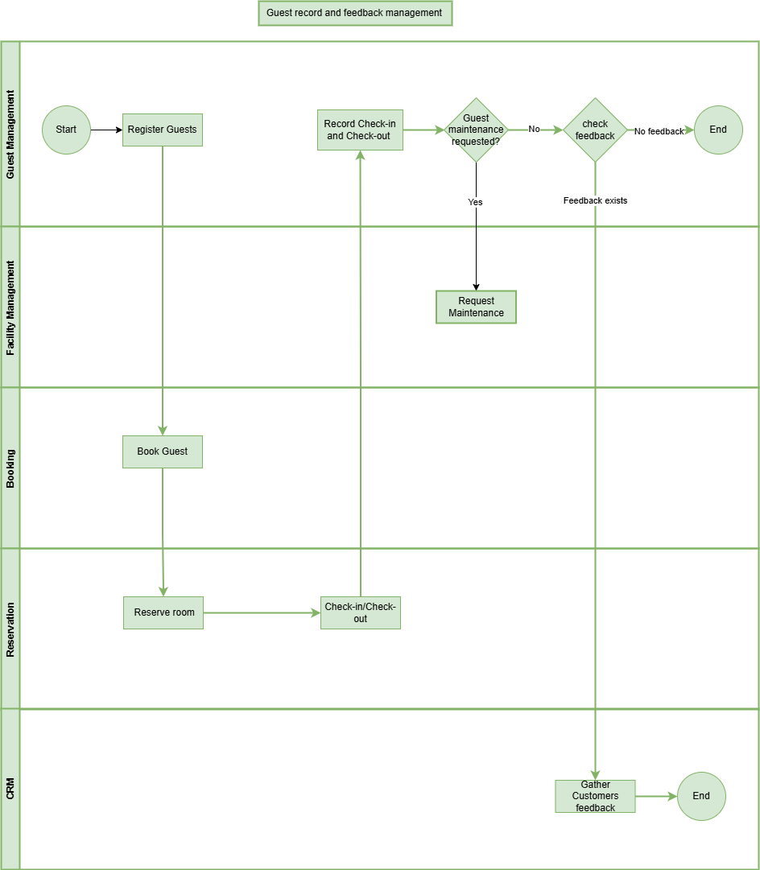
CUSTOMER/GUEST MANAGEMENT
AS IS TO BE

Slide 7
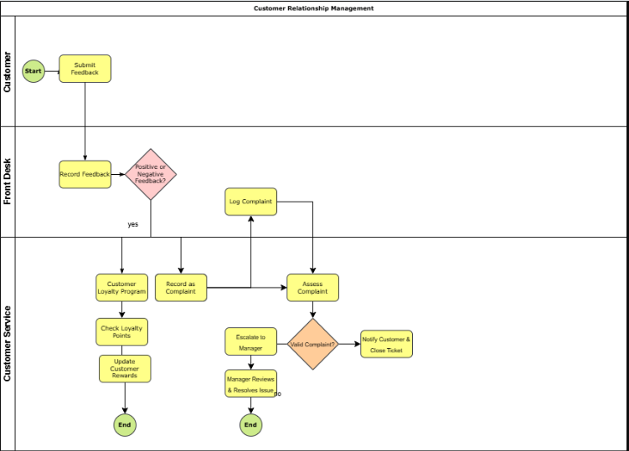
CUSTOMER RELATIONSHIP MANAGEMENT
AS IS TO BE

Slide 8
DATAFLOW DIAGRAM

Slide 9
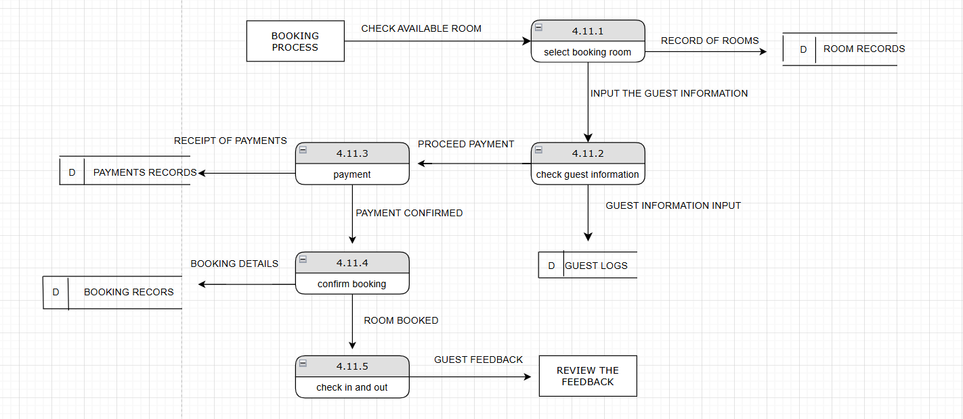
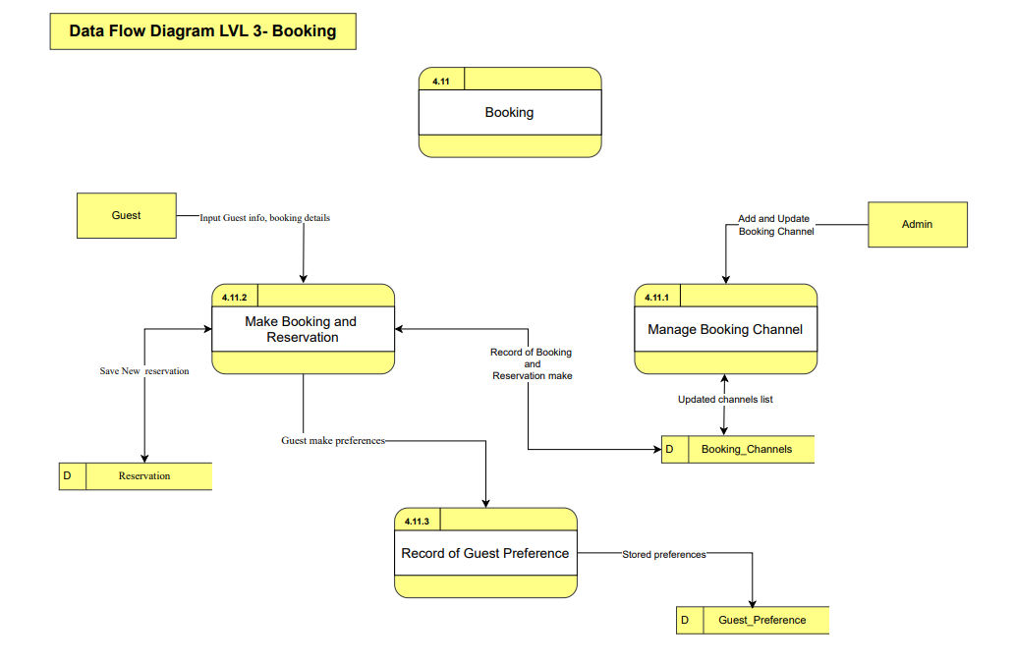
BOOKING
AS IS TO BE

Slide 10
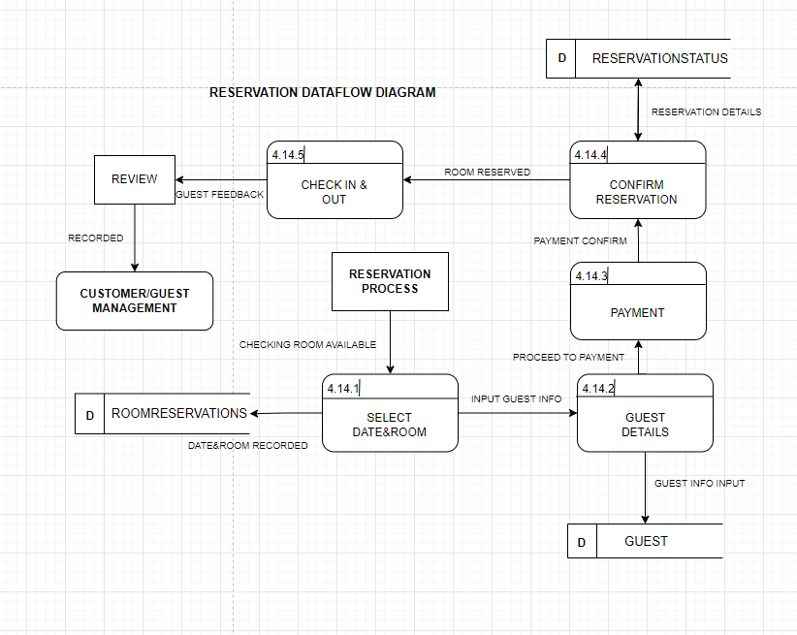
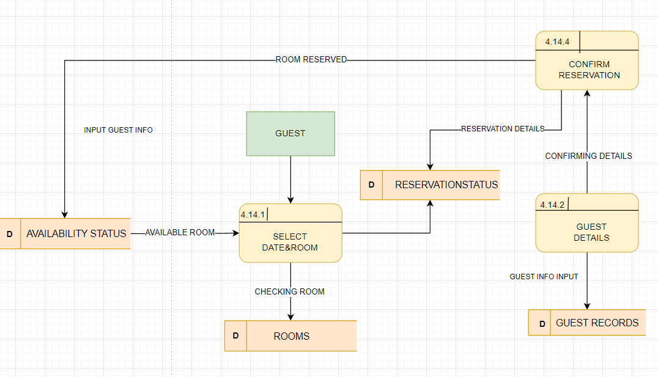
RESERVATION
AS IS TO BE

Slide 11
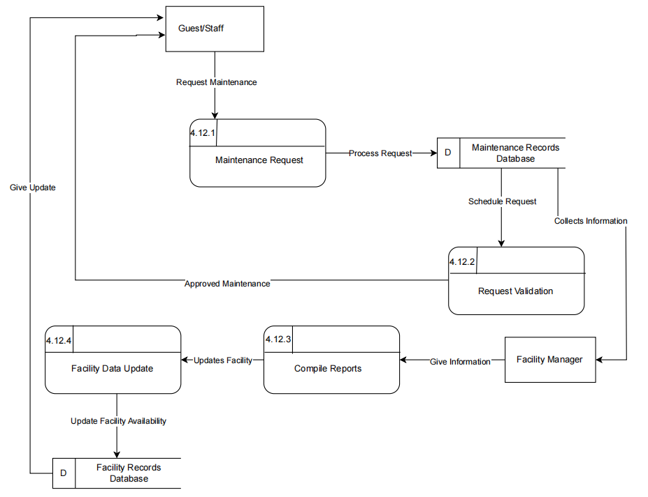
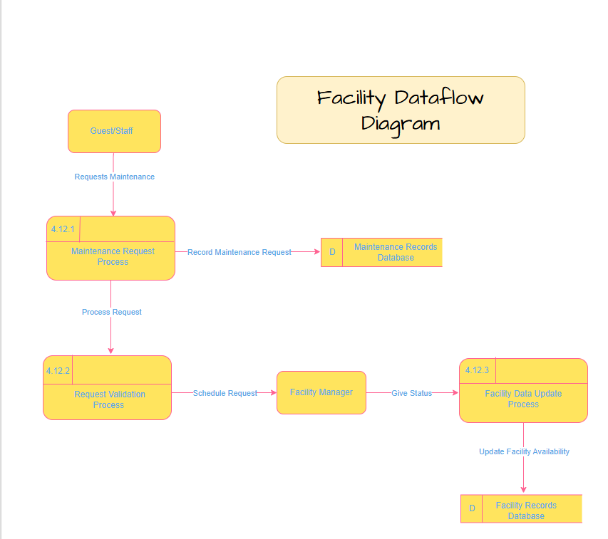
FACILITY MANAGEMENT
AS IS TO BE

Slide 12
CUSTOMER/GUEST MANAGEMENT
AS IS TO BE

Slide 13
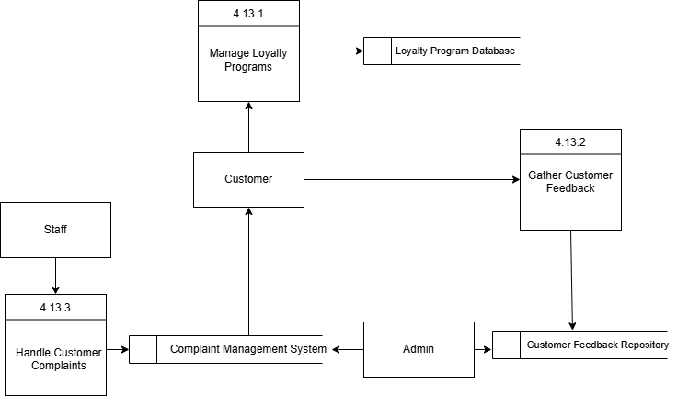
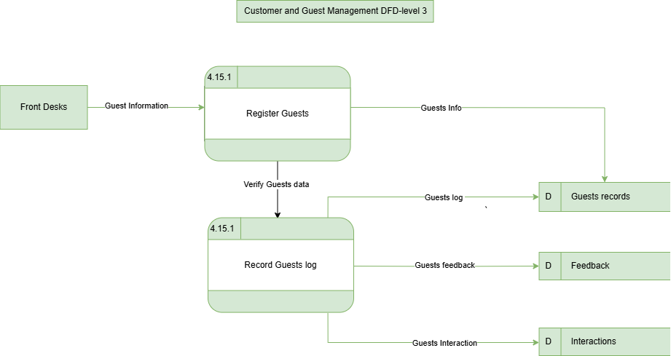
CUSTOMER RELATIONSHIP MANAGEMENT
AS IS TO BE

Slide 14
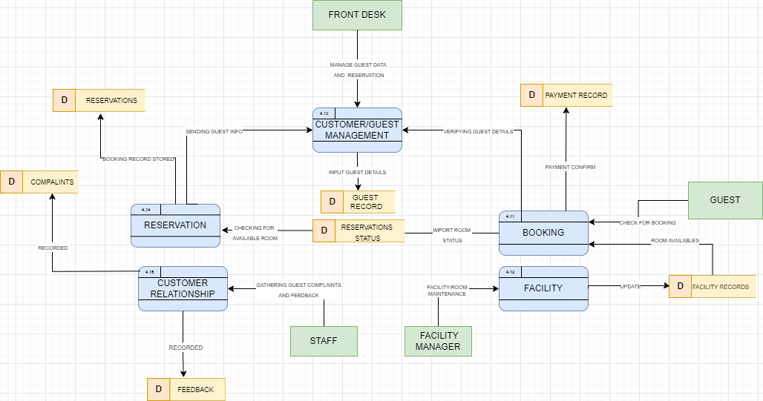
DATAFLOW DIAGRAM LEVEL 2

Slide 15
USE CASE

Slide 16
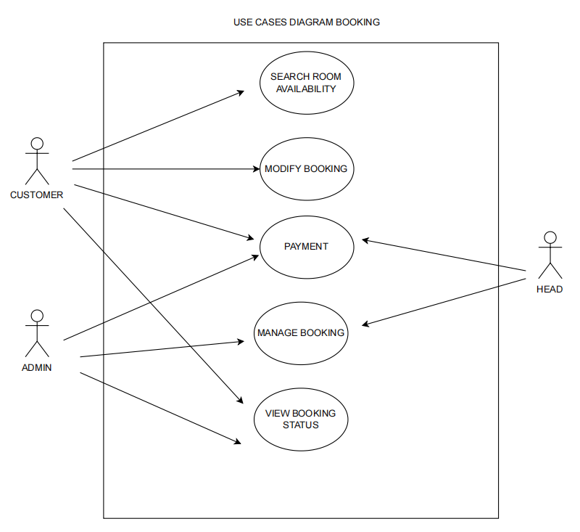
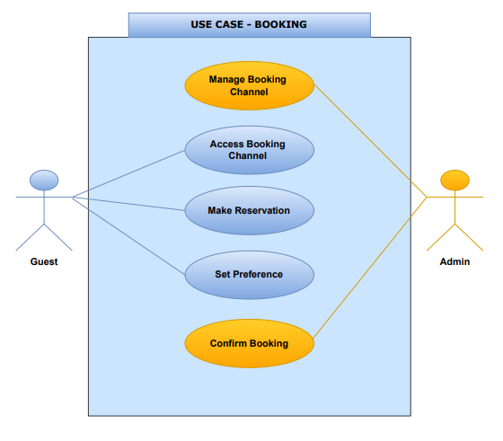
BOOKING
AS IS TO BE

Slide 17
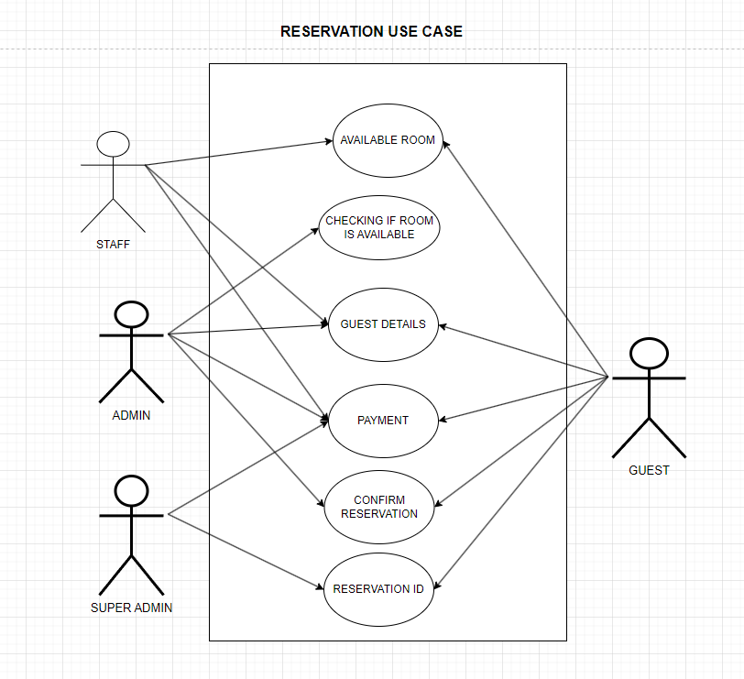
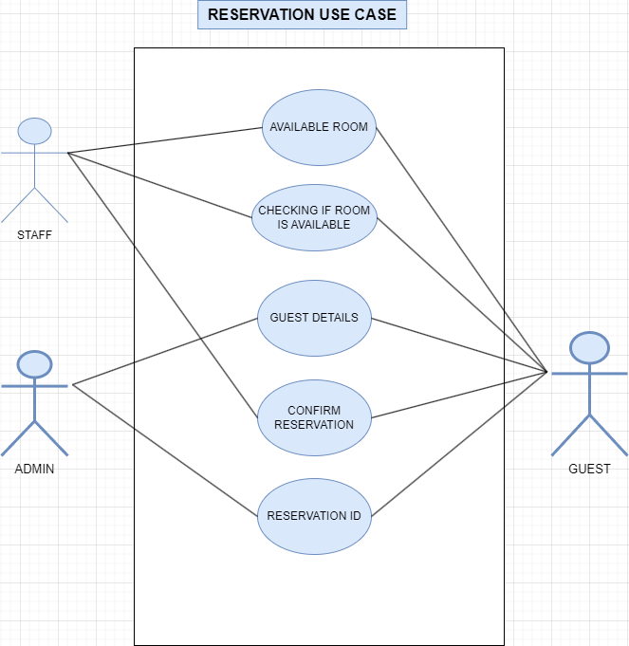
RESERVATION
AS IS TO BE

Slide 18
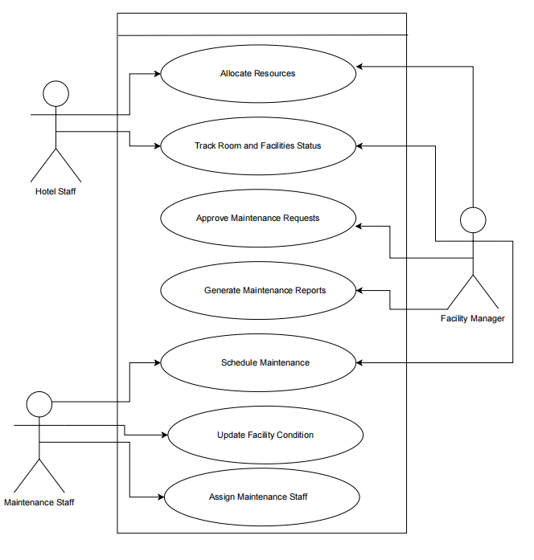
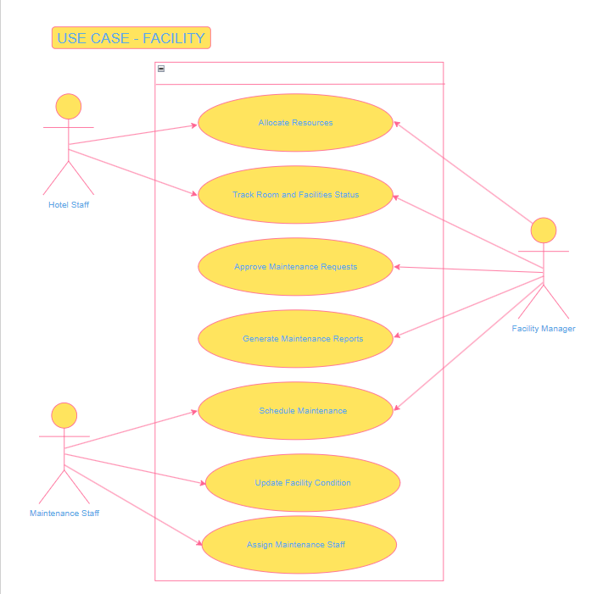
FACILITY MANAGEMENT
AS IS TO BE

Slide 19
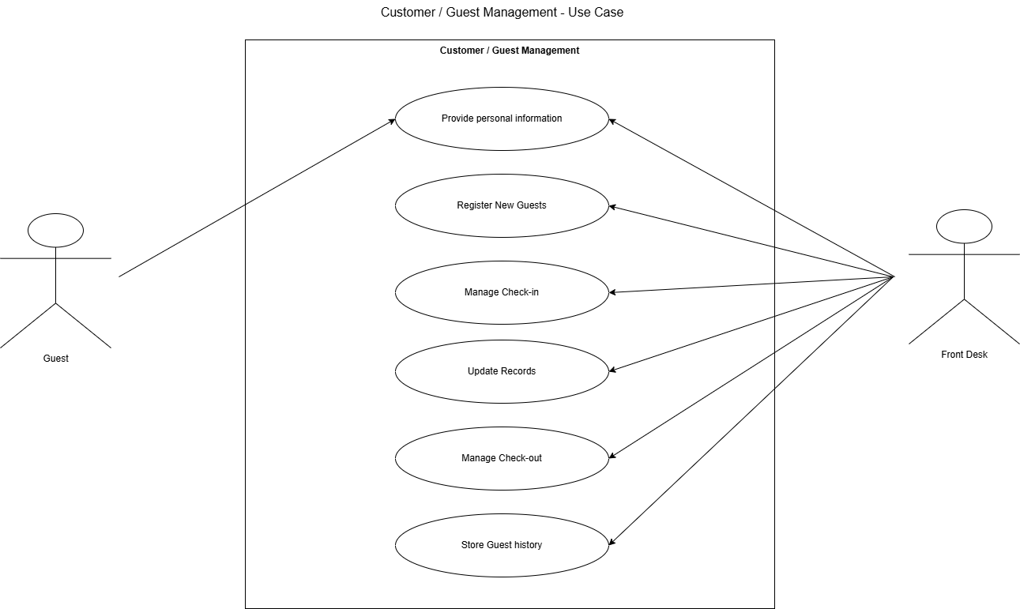
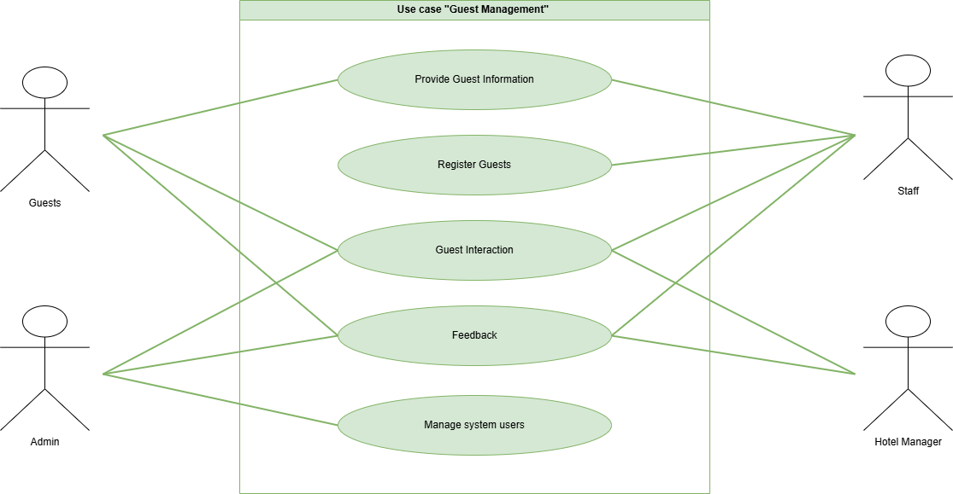
CUSTOMER/GUEST MANAGEMENT
AS IS TO BE

Slide 20
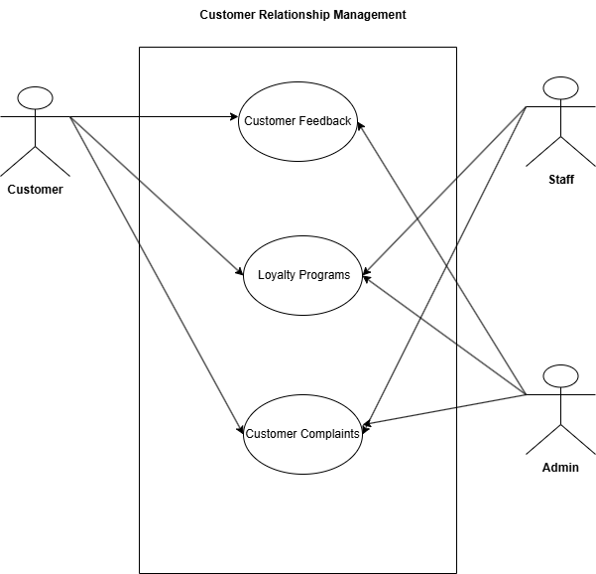
CUSTOMER RELATIONSHIP MANAGEMENT
AS IS TO BE

Slide 21
BUSINESS PROCESS ARCHITECTURE LEVEL 3

Slide 22
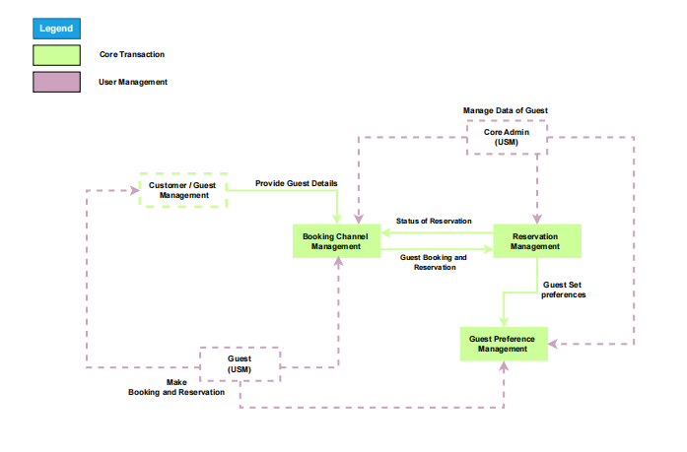
BOOKING

Slide 23
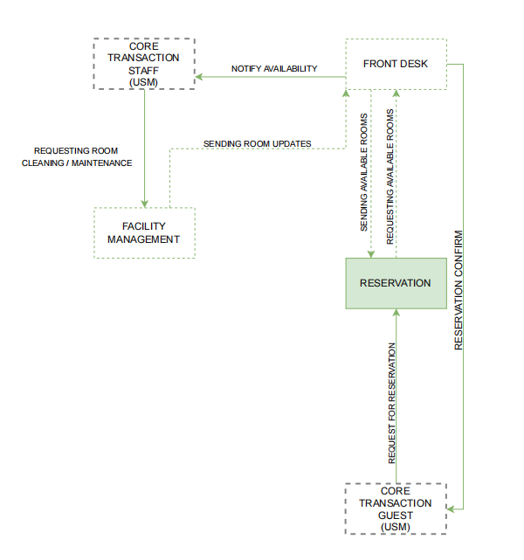
RESERVATION

Slide 24
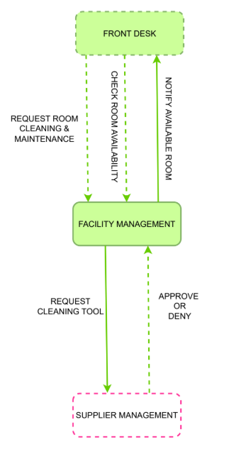
FACILITY MANAGEMENT

Slide 25
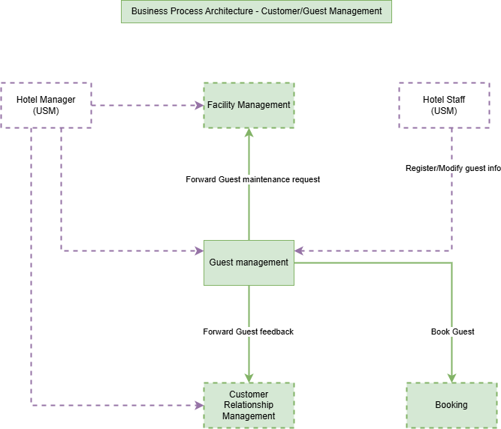
CUSTOMER/GUEST MANAGEMENT

Slide 26
CUSTOMER RELATIONSHIP MANAGEMENT

Slide 27
ENTITY RELATIONSHIP DIAGRAM CORE TRANSACTION 3

Slide 28
